Slide 1
Integral Field Spectroscopy
and Fixed Slits
Juan Espejo
JWST MASTER CLASS MELBOURNE 2022

Slide 2
Integral Field Spectroscopy

Slide 3
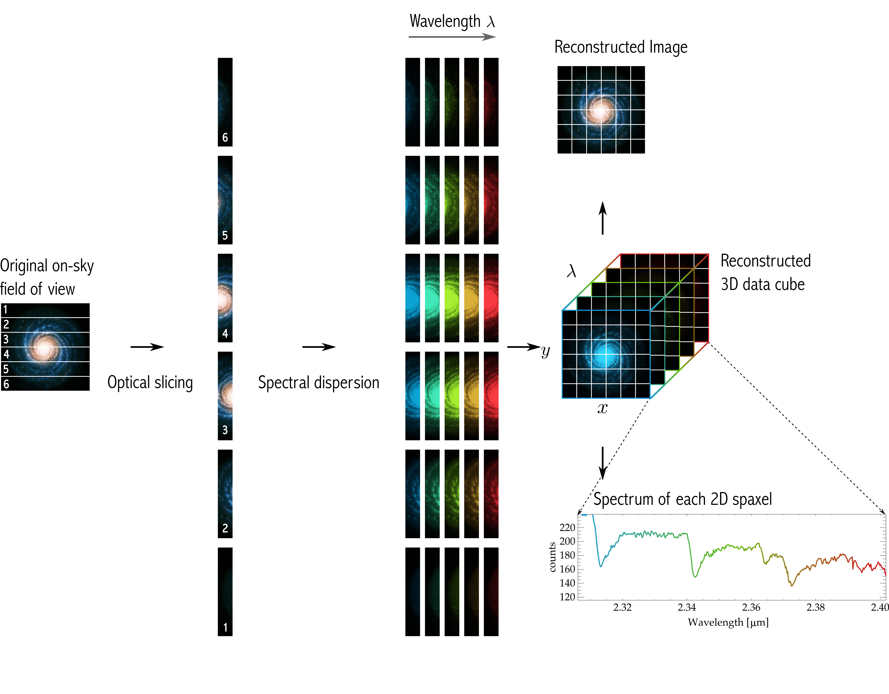
Concept
MIRI and NIRSpec use Image Slicer IFUs
Slices are dispersed in wavelength
Signal Recorded on detector
Pipeline constructs cubes from slices

Slide 4

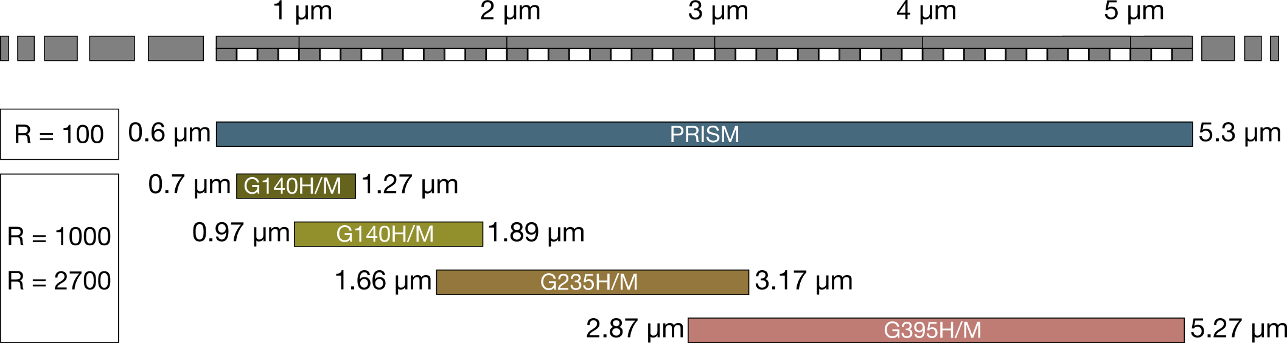
NIRSpec: IFU Overview
Concept | Advanced Image Slicer Module
Number of Slices | 30
Field of View | 3’’ x 3’’
Spaxel Size | 0.1’’ x 0.1’’
Configurations
3”
3”
0.1”
Wavelength cut-off

Slide 5
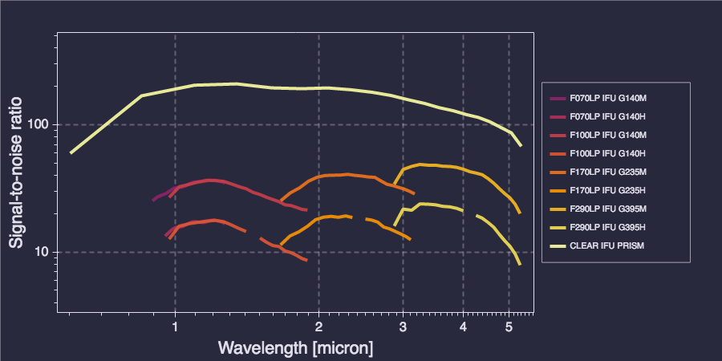
NIRSpec IFS: Sensitivity
PS, 18 ABmag, 300s
DISCLAIMER: Data taken from https://jist.stsci.edu/jist, will likely change with new ETC release

Slide 6
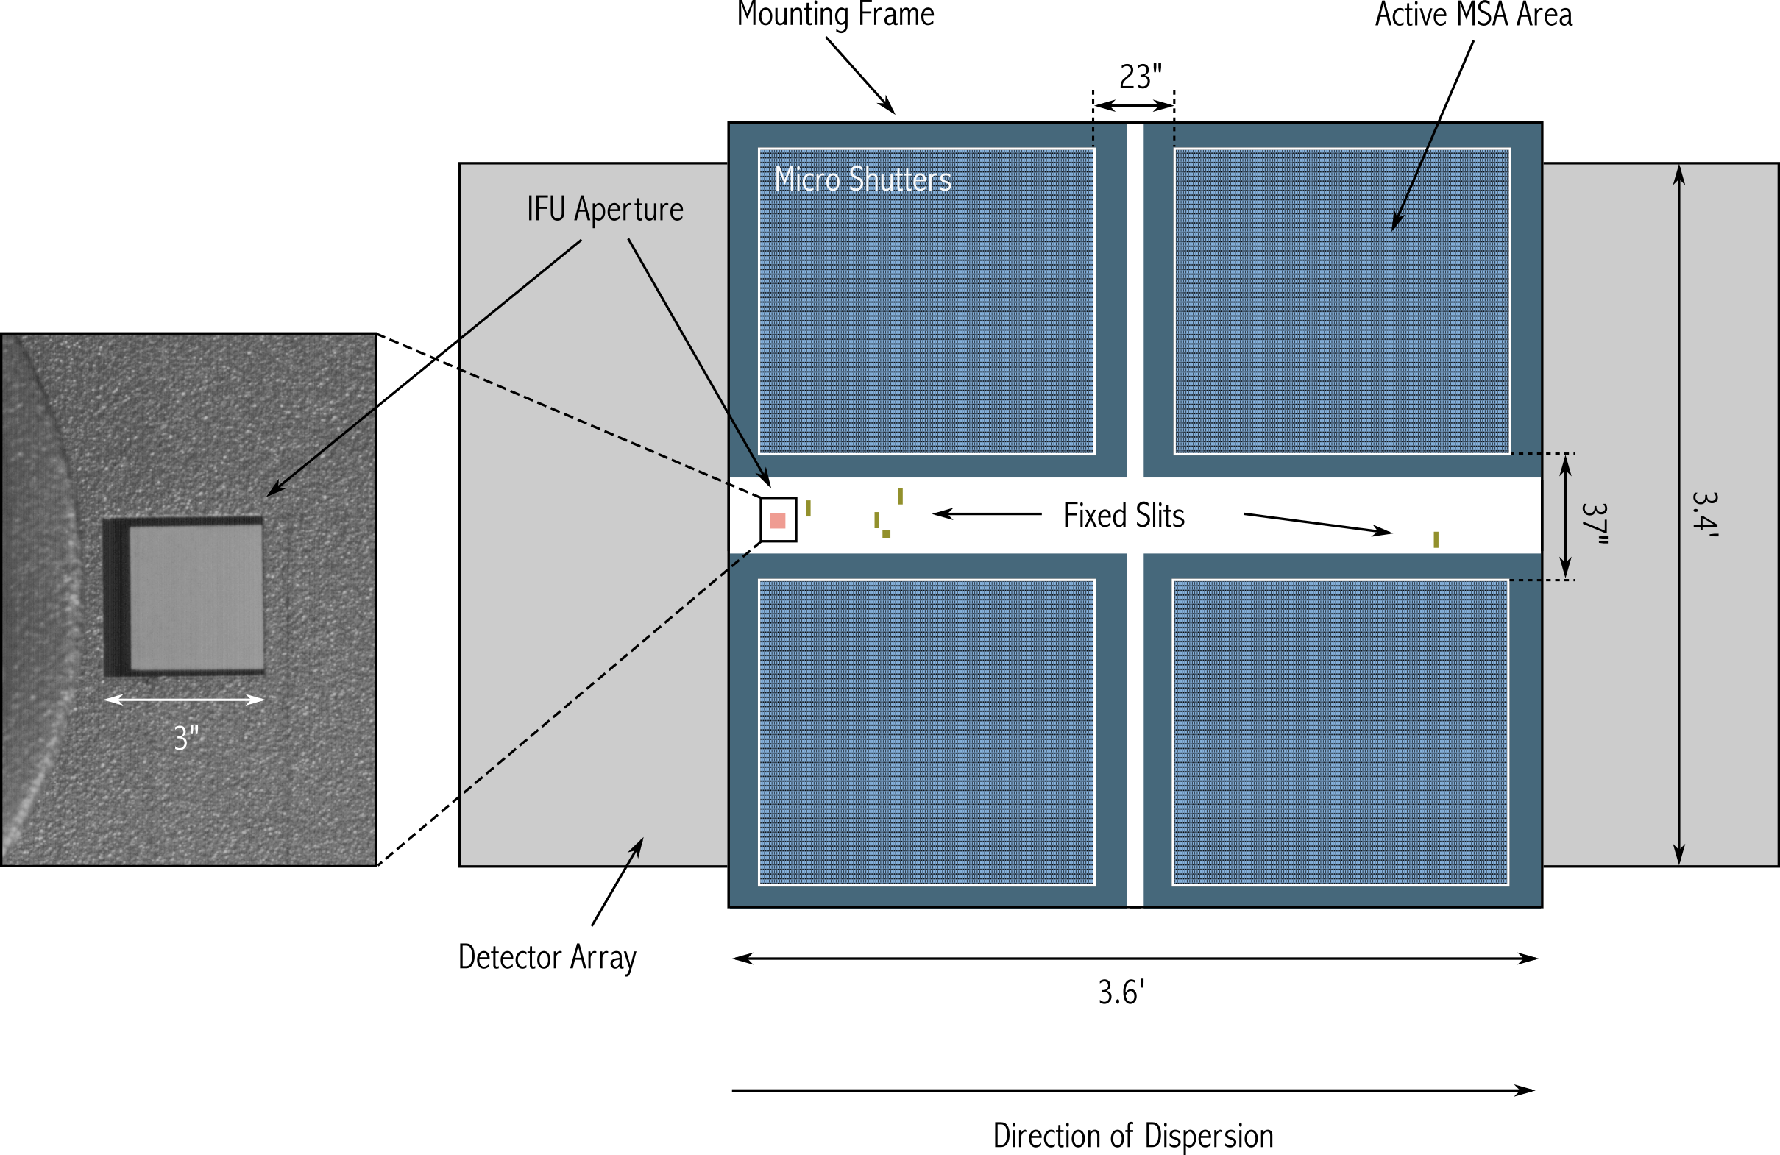
NIRSpec: Hardware

Slide 7
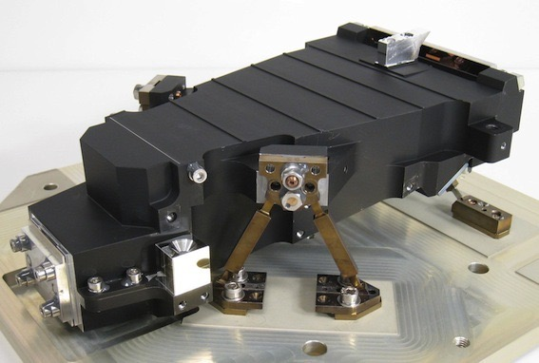
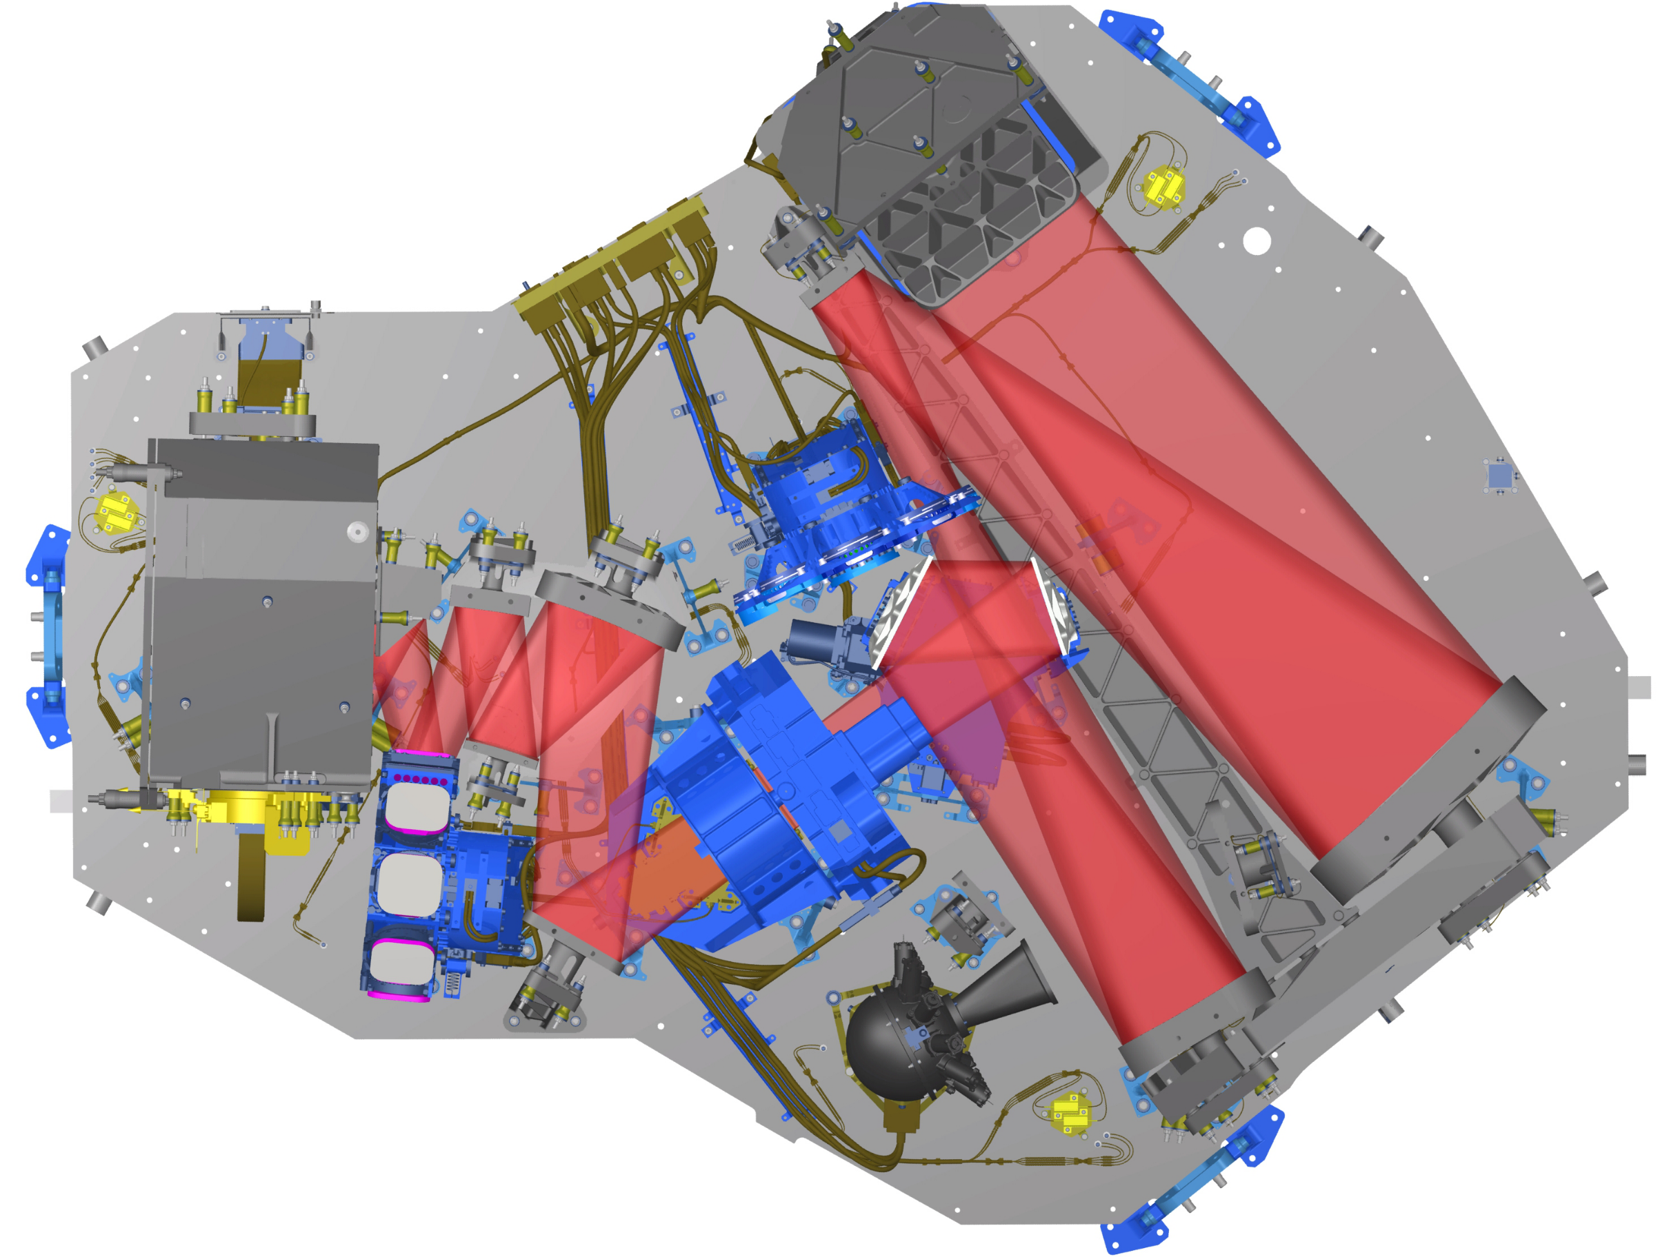
NIRSpec: Hardware

Slide 8
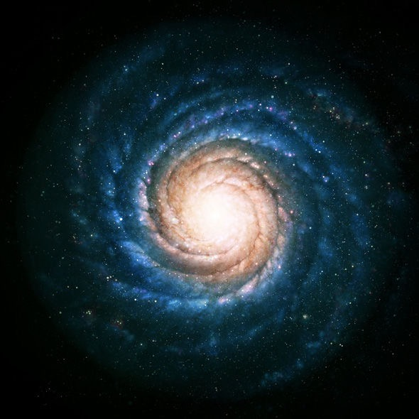
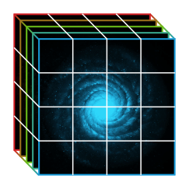
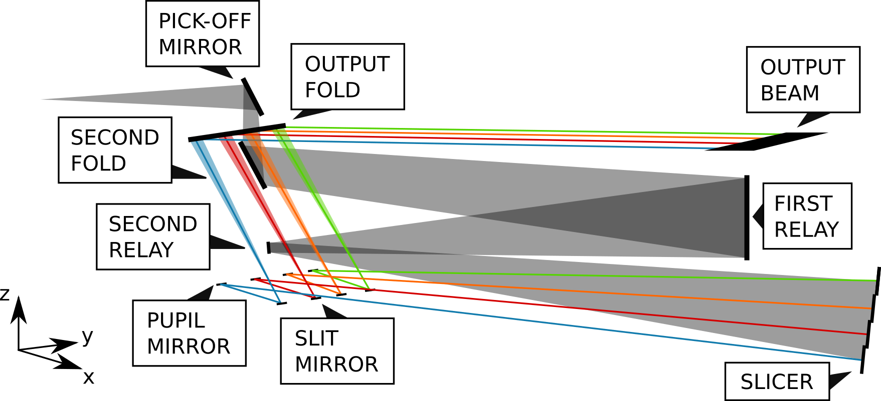
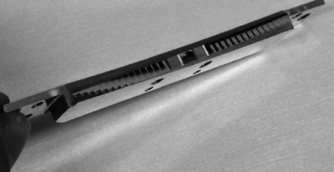
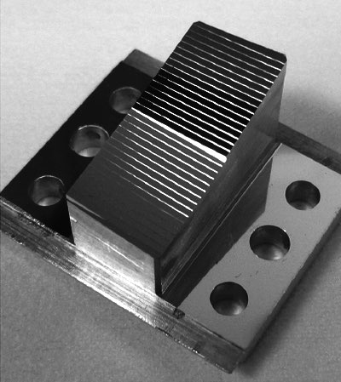
NIRSpec: Light Path

Slide 9
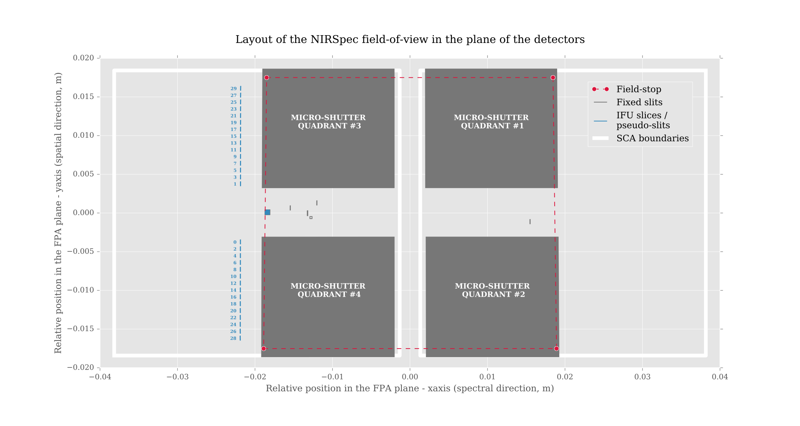
NIRSpec: Location of Slits on Detector

Slide 10
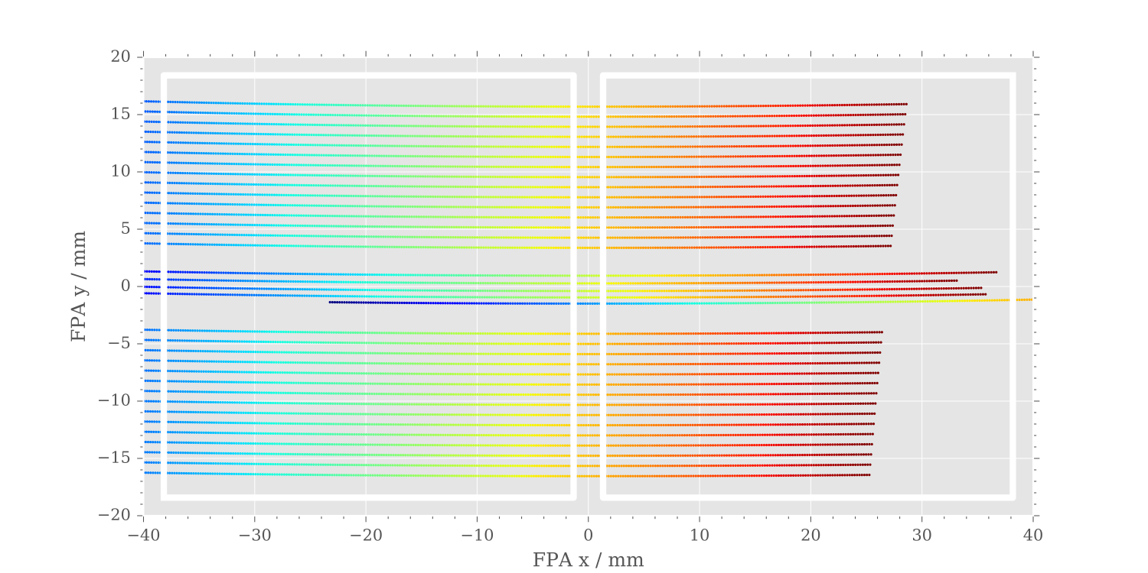
NIRSpec: Dispersed
Two detector arrays

Slide 11

NIRSpec: MSA Leakage
Light from the IFU is dispersed onto the detector across the same pixel region as spectra obtained in the MSA mode

Slide 12

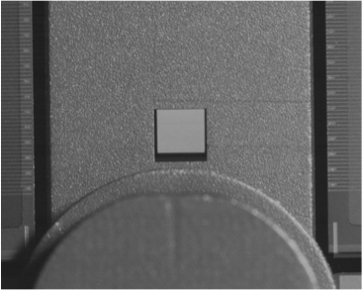
NIRSpec: MSA Leakage

Slide 13
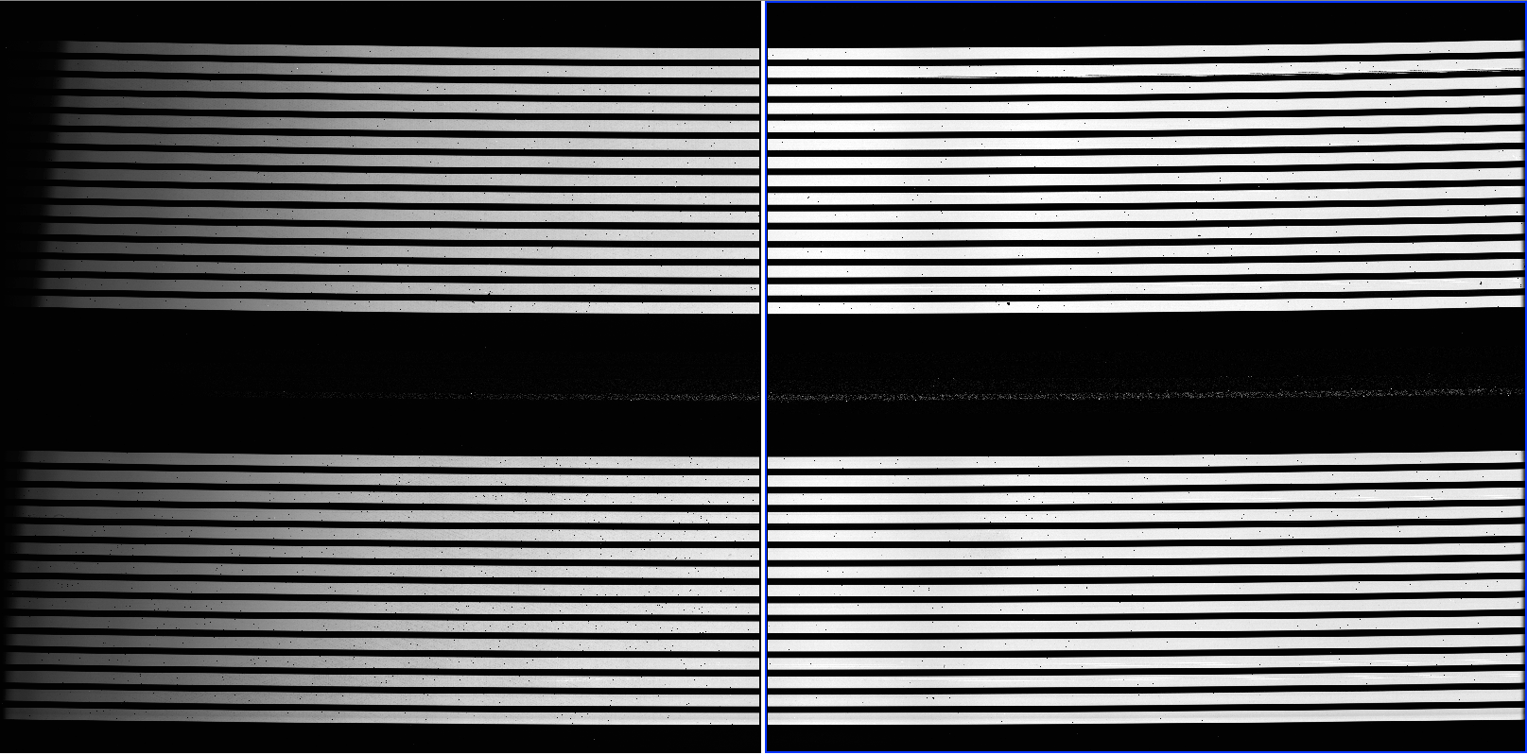
NIRSpec: MSA Leakage

Slide 14
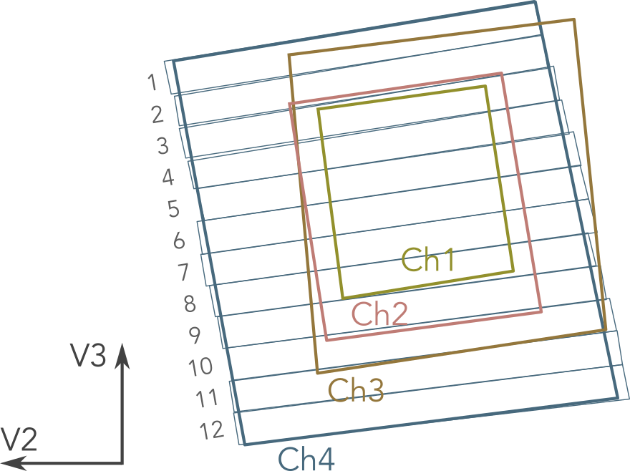
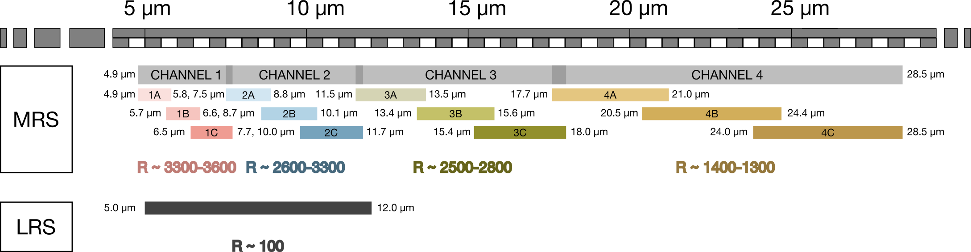
MIRI: MRS (Medium Resolution Spectroscopy) Overview
Concept | Advanced Image Slicer Module
Number of Slices | 30
Field of View | 3’’ x 3’’
Slice Size | 0.1’’ x 0.1’’
Configurations
CH1 | CH2 | CH3 | CH4
21 | 17 | 16 | 12
3.3” × 3.7” | 4.2” × 4.8” | 5.6” × 6.2” | 7.2” × 7.9”
0.176” | 0.277” | 0.387” | 0.645”
four channels (four different IFU) to keep a constant ratio of PSF size to slice size
Notes:
four channels (four different IFU) to keep a constant ratio of PSF size to slice size
Three bands per channel (need three observations otherwise it will be a patchy spectrum)
Two different detectors (IFU short and IFU long that each display two channels) in one exposure all four channels will be taken.

Slide 15
MIRI: MRS Overview
Channel | Band | Nr. slices | Wavelength Range [μm] | Spectral Resolution | FoV [arcsec]
1 | 1A |  | 4.88 - 5.77 |  | 3.46 x 3.72
 | 1B | 21 | 5.64 - 6.67 | ~3500 | 3.46 x 3.72
 | 1C |  | 6.50 - 7.70 |  | 3.41 x 3.72
2 | 2A |  | 7.47 - 8.83 |  | 4.16 x 4.76
 | 2B | 17 | 8.63 - 10.19 | ~3000 | 4.16 x 4.76
 | 2C |  | 9.96 - 11.77 |  | 4.12 x 4.76
3 | 3A |  | 11.49 - 13.55 |  | 6.00 x 6.24
 | 3B | 16 | 13.28 - 15.66 | ~2600 | 5.96 x 6.24
 | 3C |  | 15.34 - 18.09 |  | 5.91 x 6.24
4 | 4A |  | 17.60 - 21.00 |  | 7.14 x 7.87
 | 4B | 12 | 20.51 - 24.48 | ~1600 | 7.06 x 7.87
 | 4C |  | 23.92 - 28.55 |  | 6.99 x 7.87
IFUSHORT
IFULONG
3 exposures needed to obtain an entire spectra

Slide 16
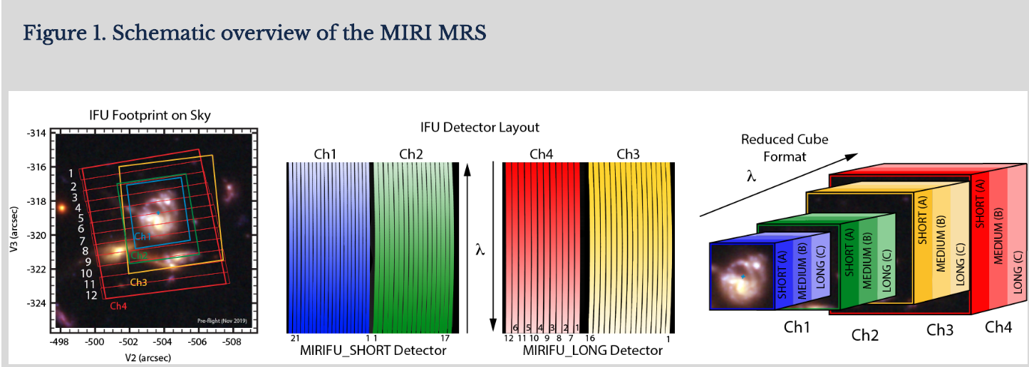
MIRI: MRS Overview

Slide 17
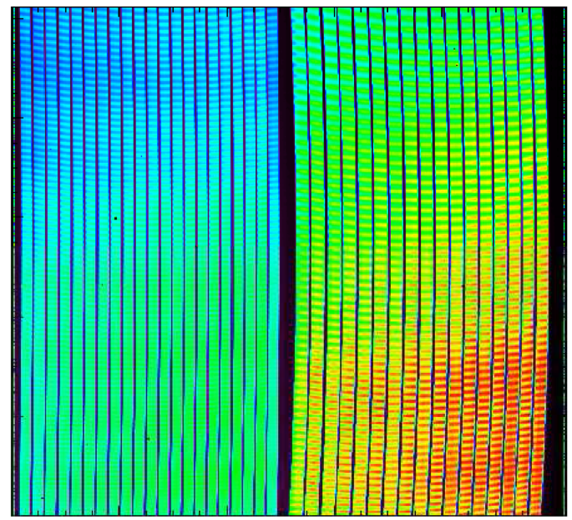
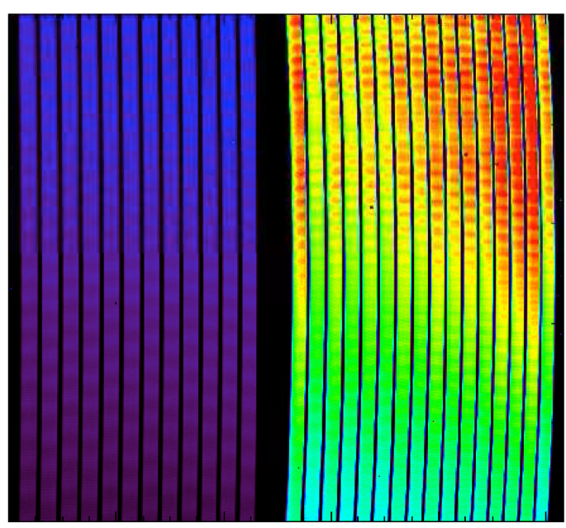
MIRI MRS: Dispersed
6.7
CHANNEL 1 & 2
10.2
20.5
CHANNEL 4 & 3
13.3
5.6
IFUSHORT
8.6
24.5
IFULONG
15.7
Notes:
The dark blue one is channel four (sensitivity is pretty bad compare to the others, see next plot)

Slide 18
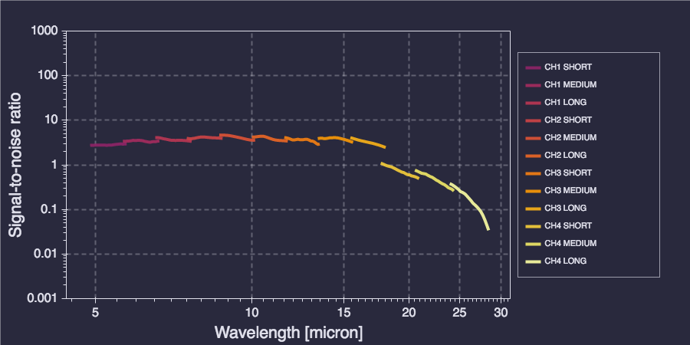
MIRI MRS: Sensitivity
PS, 18 ABmag, 300s
DISCLAIMER: Data taken from https://jist.stsci.edu/jist, will likely change with new ETC release

Slide 19
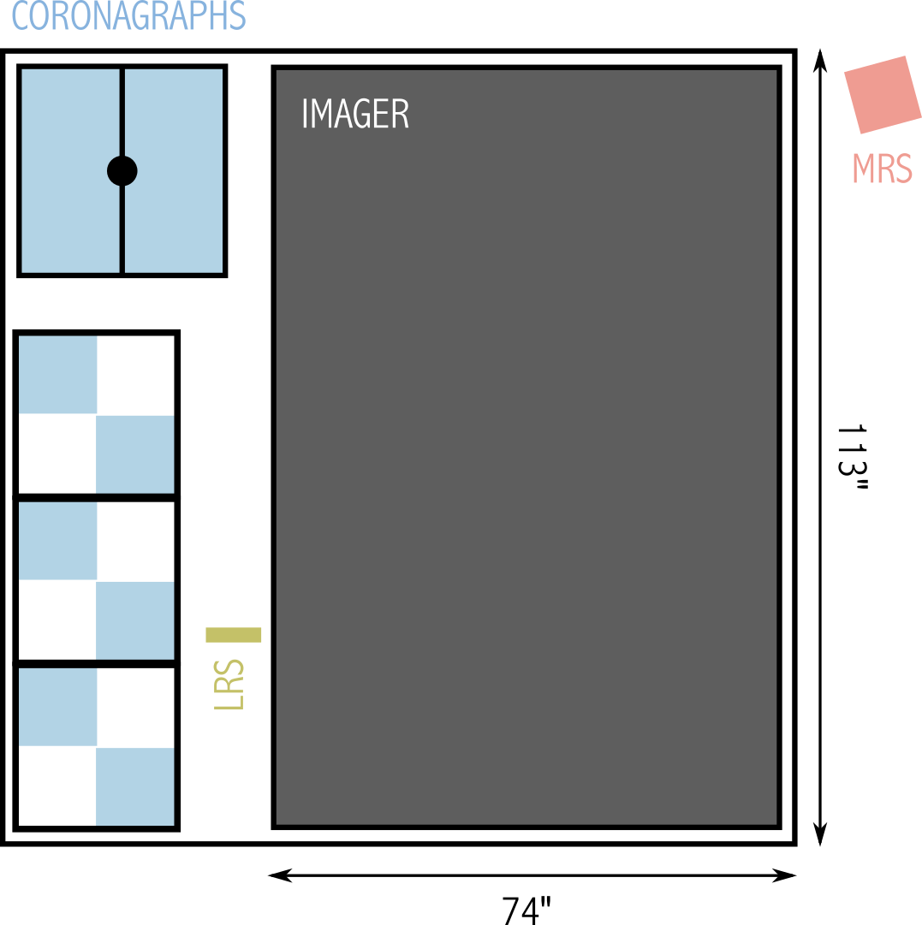
MIRI: Hardware

Slide 20
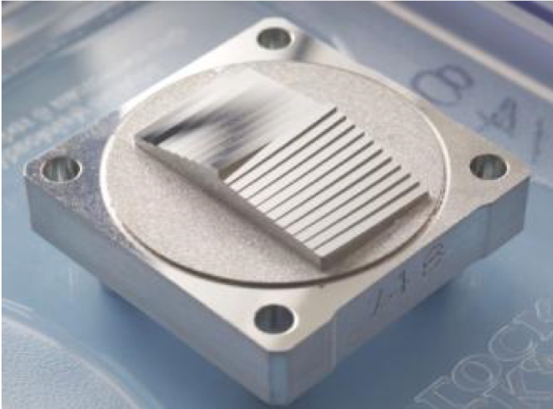
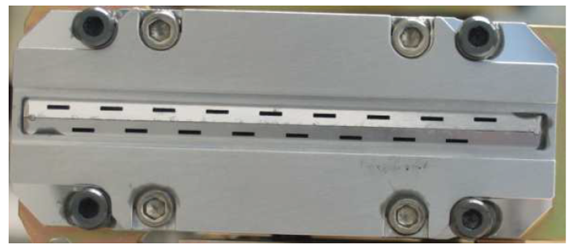
MIRI: Hardware
Exit Slits
Slicer

Slide 21
Fixed Slits

Slide 22
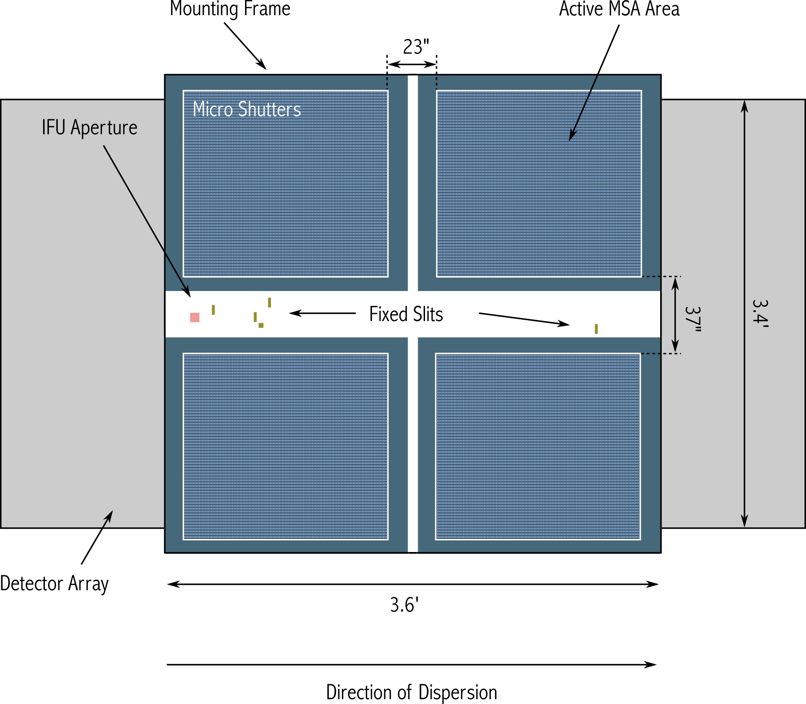
The FS of MIRI and NIRSpec

Slide 23
NIRSpec FS Basics and Design
FIXED SLIT SPECTROSCOPY | Single (compact) object (high contrast) | 0.2’’ x 3.2’’ slits (3) 0.4’’ x 3.65’’ slit 1.6” x 1.6” aperture
BRIGHT OBJECT TIME SERIES | e.g. Transit/eclipse spectroscopy | 1.6’’ x 1.6’’ aperture
S200A1
S200A2
Six gratings and one prism available as dispersers (full wavelength range)
S400A1
S1600A
NIRSpec FS are designed for high contrast spectroscopy e.g. required for spectroscopic observations of transiting extra-solar planets

Slide 24

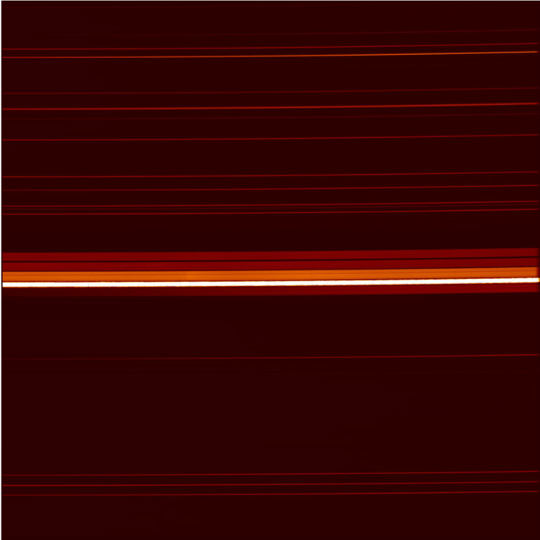
NIRSpec FS Basics and Design
Fixed Slit Spectra

Slide 25
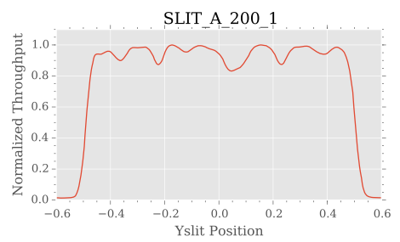
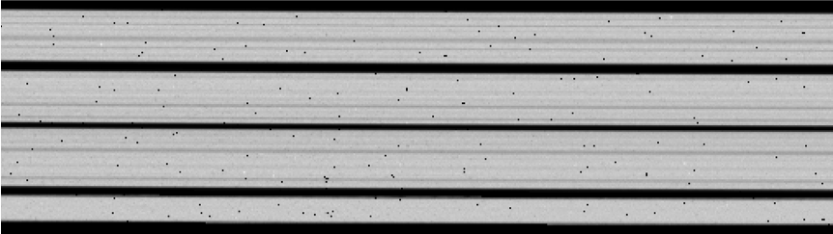
NIRSpec FS “stripy-ness”
The S200 and S400A1 slits have width variations of up to 20% (P-V)
Expected to mostly flat field out
Nodding positions are defined to avoid the narrower slit regions (valleys) where possible
Slit losses (for point sources) will be calibrated at the defined nod/dither positions

Slide 26
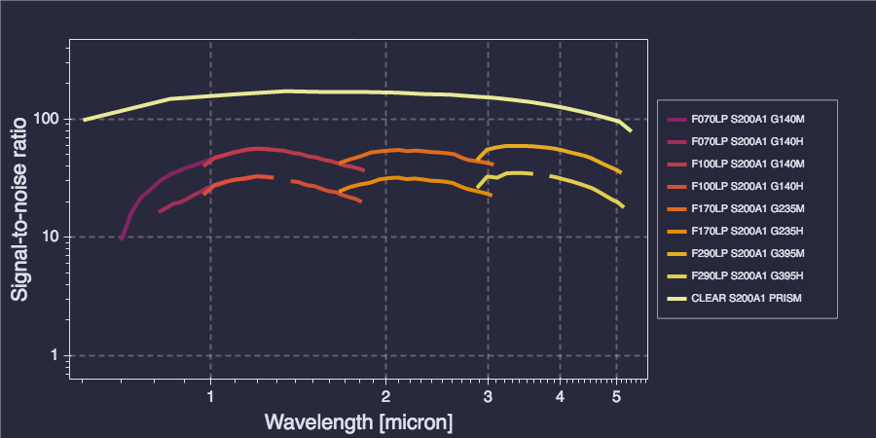
NIRSpec FS: Sensitivity
PS, 18 ABmag, 300s
DISCLAIMER: Data taken from https://jist.stsci.edu/jist, will likely change with new ETC release

Slide 27

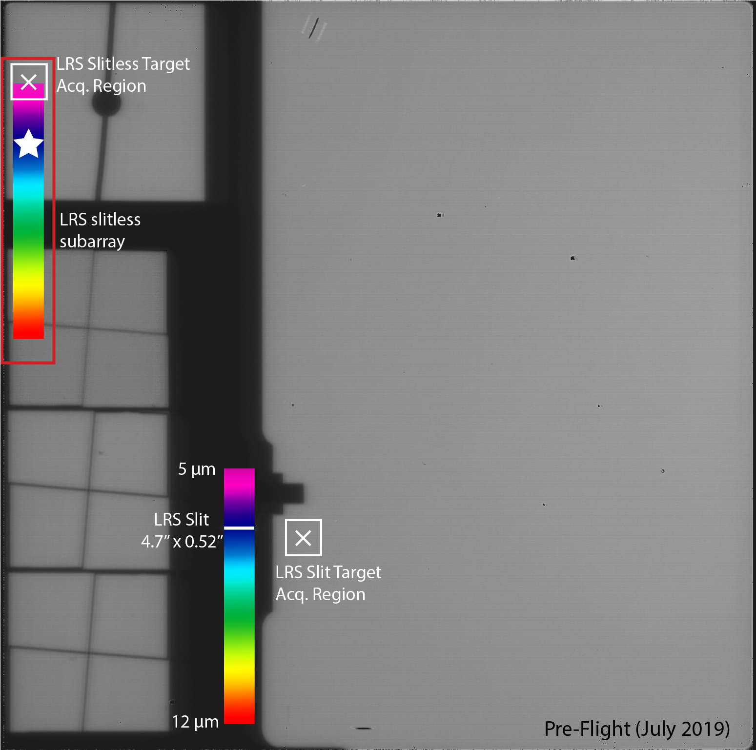
MIRI LRS (Low resolution spectroscopy) Basics and Design
R ~ 100 spectroscopy of compact source from 5-12 µm (~40 to 160 over the 5-10 µm range)
Can be operated slitted (4.7 x 0.52’’) or slitless mode
Shares focal plane with imager & coronagraph modes
Dispersion via double prism in filter wheel
Notes:
when you use the slit everything else in the image field of view and coronagraphs will be dispersed as well in slitless mode
This will not be supported in cycle 1 but the user is free to use this data if they can reduce it

Slide 28

MIRI LRS Basics and Design
SLIT | SLITLESS
Not available for Time Series Observations | Time Series Observation setting mandatory
FULL array | SLITLESSPRISM subarray
Better sensitivity, fainter saturation limit | Worse sensitivity, brighter saturation limit
Exposures limited to 10,000 s | Allows > 10,000 s exposures
Dithering possible | No dithering allowed
No spectral foldover below ~4.5 µm | Affected by spectral foldover < 4.5 µm
Sensitive to pointing uncertainty, drift | No slit losses (TA mandatory)
Time Series Observation special requirement not permitted | Time Series Observation special requirement mandatory
Notes:
mentioning slitless here because the TSO session will be very short
Slitltess is for two only

Slide 29
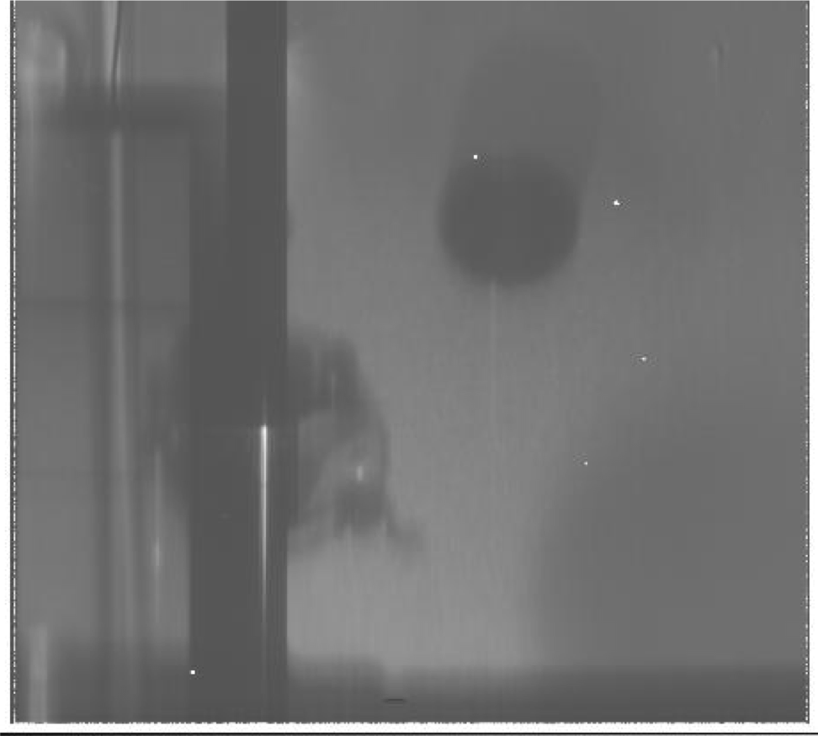

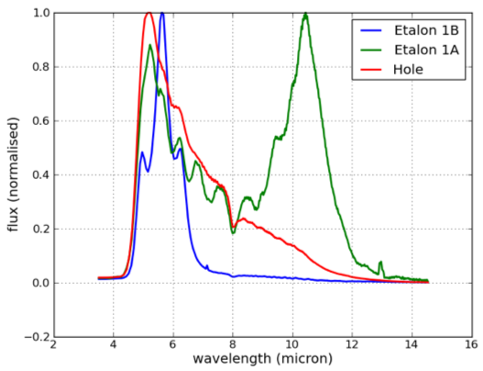
MIRI LRS Spectrum
Notes:
- spectrum of a point source from a cryo-vacuum test campaign

Slide 30
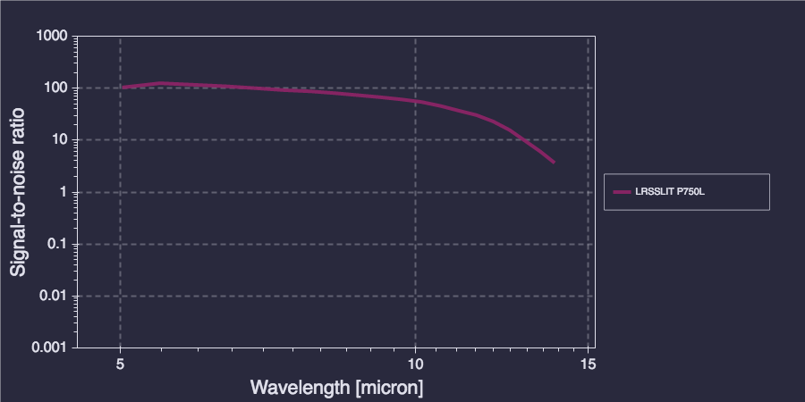
MIRI LRS: Sensitivity
PS, 18 ABmag, 300s
DISCLAIMER: Data taken from https://jist.stsci.edu/jist, will likely change with new ETC release

